Slide 2

Ready, Set, Architect!
300* seconds to free architecture
Ron Parker | @scmunk
Notes:
*300+

Slide 3
DISCLAIMER
I, Ronald L. Parker, aka @scmunk, make no claims, promises, or guarantees about the accuracy, completeness, or adequacy of the contents of this presentation or the words that are used during this presentation and expressly disclaims liability for errors and omissions in any content while I also claim that this presentation isn’t in any way related to my employer, or employers no matter how similar the content may seem, sound, or otherwise how it may have any molecular resemblance to anything related to any other entity with that being said everything related to this session is completely based on my opinion and right about now is when you insert some random Latin filler phrases to make it look like there is more verbiage than there actually is although no one really cares at the end of the day.

Slide 4
Agenda
Why do we have architecture and what does it look like?
What are some approaches or frameworks for architecture?
What tools can be used?
Notes:
So lets go back to the beginning

Slide 5
Notes:
Architecture is used to describe stuff – could be anything really

Slide 6
Notes:
Usually you end up with more than one thing to talk about

Slide 7
ClickChat Client
ClickChat App Server
Notes:
In the real world most things are related in one or more ways, sometime we take it for granted sometimes we have to be explicit
We are at a Dev thing so lets make this more real

Slide 8
ClickChat Client
ClickChat App Server
ClickChat App Server
Notes:
Because we expect to be bigger than Zuckerberg we need to make sure we have some redundancy, some uptime, Some Netflixish behavior

Slide 9
ClickChat Client
ClickChat App Server
ClickChat App Server
Notes:
Because we expect to be bigger than Zuckerberg we need to make sure we have some redundancy, some uptime, Some Netflixish behavior

Slide 10
ClickChat Client
ClickChat App Server
ClickChat App Server
Notes:
Because we expect to be bigger than Zuckerberg we need to make sure we have some redundancy, some uptime, Some Netflixish behavior

Slide 11
ClickChat App Server
ClickChat Client
Router
ClickChat App Server
Notes:
We need Resiliency, Redundancy, NFRs

Slide 12
ClickChat App Server
ClickChat Client
Router
ClickChat App Server
Notes:
We need Resiliency, Redundancy, NFRs

Slide 13
ClickChat App Server
ClickChat Client
Router
ClickChat App Server
Notes:
We need Resiliency, Redundancy, NFRs

Slide 14
ClickChat App Server
ClickChat Client
Router
ClickChat App Server
Notes:
We need Resiliency, Redundancy, NFRs

Slide 15
ClickChat App Server
ClickChat Client
Router
ClickChat App Server
Notes:
We need Resiliency, Redundancy, NFRs

Slide 16
ClickChat App Instance
Datomic
ClickChat Client
Router
ClickChat App Instance
Datomic
Notes:
Instance

Slide 17
What did we just do?
ClickChat App Instance
Datomic
ClickChat Client
Router
ClickChat App Instance
Datomic
Notes:
We architect to optimize the whole

Slide 18
How did we approach system resiliency?
ClickChat App Instance
Datomic
ClickChat Client
Router
ClickChat App Instance
Datomic
Notes:
We architect to optimize the whole – we needed the whole system to be resilient, to have those NFRs – not just one piece
Any one elements would not have worked – have to work together
This can be incremental – not BDUF

Slide 19
We architect to optimize
the whole,
not just the pieces.
Notes:
We architect to optimize the whole

Slide 20
AWS Direct Connect
ClkApp::
VI001
Datomic::
DB001
HTTPS/REST
Containers
Spawned Based
On Usage
ClickChat::Clkclnt.exe
Router::
LBC001
HTTPS/REST
Catalog replication
HTTP Node-based
Router
HTTPS/REST
ClickApp::
VI002
Datomic::
DB002
Cloud Stuff
PaaS Stuff
Notes:
Be a little more detailed, for security, operations, engineers

Slide 21
VIEWS
Notes:
We have been building VIEWS, a lot of architecture is about communication

Slide 22
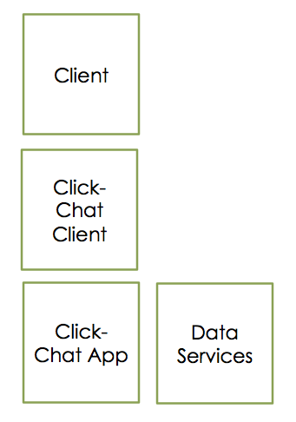
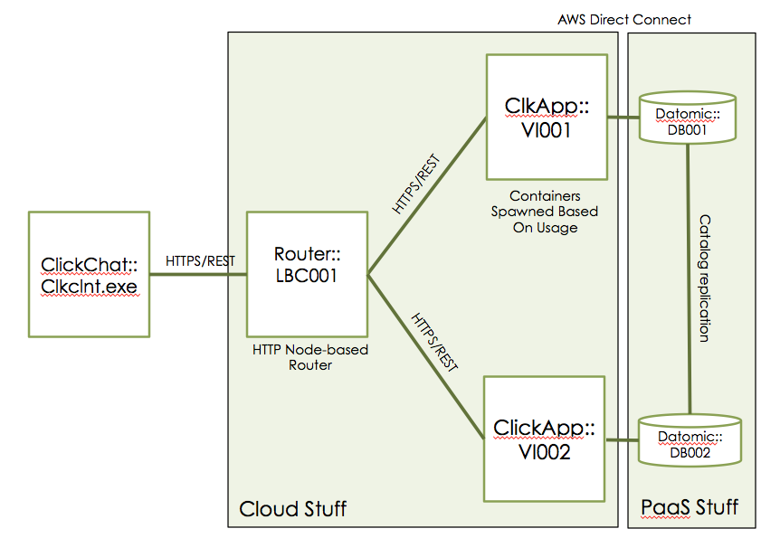
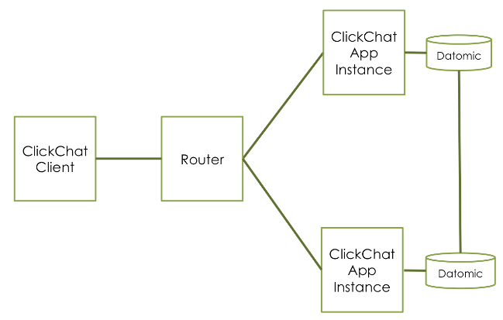
Different views for different audiences – Same Systems
Conceptual
Logical
Physical
More ideas
Planning
Management
Gaps
Relations
Behavior
Components
Functions
Integration
Solutioning
Implementation
Operations
Solutioning
More Concrete
Notes:
Conceptual logical physical component function on lines

Slide 23
Galactic Modeling Language
Box
GML
A small, cross-platform, but still robust approach for describing architecture
Line
Label
Label
Notes:
All downhill from here, the rest is easy if you understand
why, views

Slide 24
All Down-Hill From Here
Understand WHY
Understand your AUDIENCE and the VIEWS
Notes:
Plus you now know GML

Slide 25
C4 Hierarchical Model
A little more specific than GML
Good for software architecture
Nested items
Context
Containers
Components
Classes or Code

Slide 26
C4 – Context (of the system)
Anonymous User
Administrator User
Enter and view Clicks
Admins rooms, walls
Click Chat
[System Software]
Post tweets
Babble endlessly
Post posts
Twitter
Facebook
Slack

Slide 27
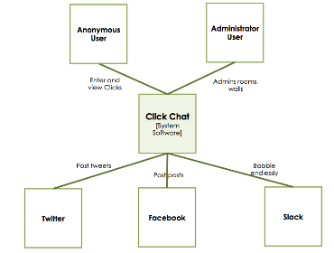
C4 - Container
Anonymous User
Administrator User
Enter and view Clicks
Admins rooms, walls
Client App
Clkcht.exe
DataStore
Datomic Sys
Integration
IntApp Node.js
Post tweets
Babble endlessly
Post posts
Twitter
Facebook
Slack
Notes:
All downhill from here, the rest is easy if you understand why, views

Slide 28
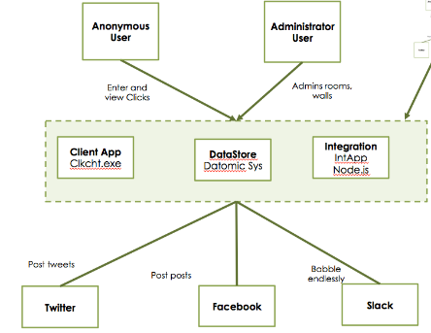
C4 - Component
DataStore
Events
Integration Components
Twitter Update
TUpdt
FB Update
FBUpdt
Slack
Babble
Post tweets
Babble endlessly
Post posts
Twitter
Facebook
Slack

Slide 29
C4 – Classes or Code
More boxes for Classes
Code
Notes:
You put all four together and you have C4, Works well for software architecture, Lightweight

Slide 30
C4
Lightweight software architecture
Based on views of the pieces and usage
Notes:
You put all four together and you have C4, Works well for software architecture, Lightweight

Slide 31
UML – Unified Modeling Language
Notes:
THE UML

Slide 32
UML – Unified Modeling Language
U M L
Notes:
Free
Real – tools – people know it somewhat
Been around a long time

Slide 33
Three Rules for Successful UML’ing
Pick out the good stuff
Only use the good stuff
Ignore anything that is not good stuff
Structural UML diagrams
Class diagram
Package diagram
Object diagram
Component diagram
Composite structure diagram
Deployment diagram
Behavioral UML diagrams
Activity diagram
Sequence diagram
Use case diagram
State diagram
Communication diagram
Interaction overview diagram
Timing diagram
Notes:
There are lots of resources and tools
You shouldn’t ignore UML
You need to know a little UML

Slide 34
Three of my favorites
Class Diagrams
Sequence Diagrams
Component Diagrams
Honorable mention to Use Case diagrams but User Stories are better
Notes:
Class diagrams are just useful – code, things, databases, or just objects
Don’t underestimate sequence – most diagrams do not show sequence and that is the firs thing that is asked
Both GML and C4 rely heavily on explaining components – UML goes all out

Slide 35
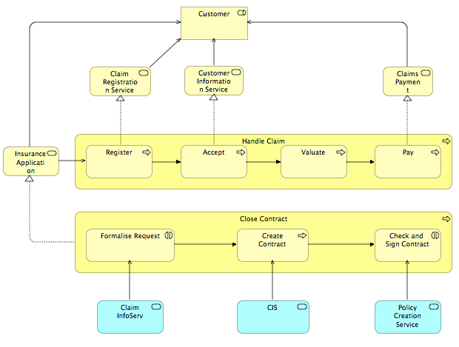
Archimate 3.0 (AR-ki-mayt)
Built by The Open Group
Strength is in connected views
Not for low level software modeling

Slide 36
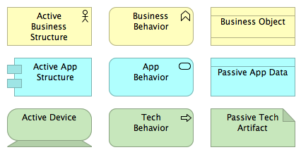
Archimate Elements
Example Elements
Notation Types
Motivation
Strategy
Business
Application
Technology
Physical
Implementation
Can be used for high level architecture and solution architecture because there is an emphasis on modeling behavior separately from implementation.

Slide 37
Frameworks
Four Examples
GML
UML
C4
Archimate
Now we need tools....

Slide 38
Tools
Tools
Drawing
Modeling
No repository of elements
Each diagram is standalone
Very easy and portable
Think Paper or Whiteboard
Repository of elements
Tied to a framework
Lots of reuse
Maybe too many rules
Diagrams relate
Notes:
What can help us do all of this? Lets look at Drawing first

Slide 39
Drawing: Paper and Pencil
Using whatever is at hand to capture an idea is better than not capturing the idea at all.
- @scmunk
Notes:
It is my goto .

Slide 40
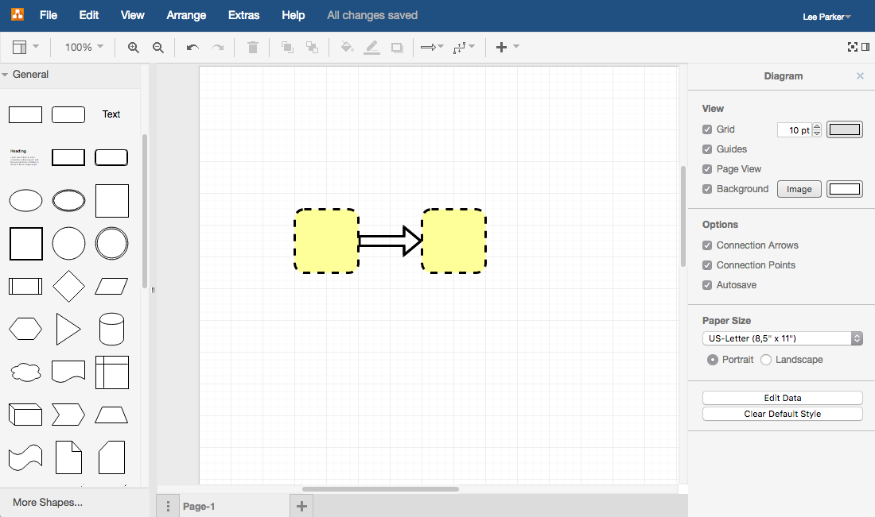
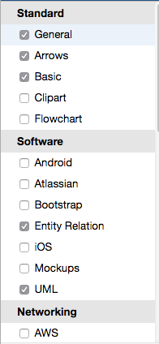
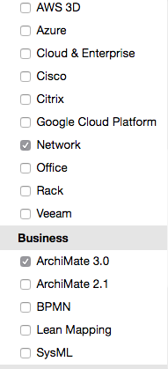
Drawing: Draw.io
100% cloud-based
Connects to cloud storage or can use local
Has shapes for UML, Archimate, AWS, Azure, UML…
Save multiple diagrams per file
Easily exports diagrams to images

Slide 41
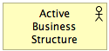
Drawing: PowerPoint (Not free but maybe at hand)
Supports GML well
Easily Import Your Own Graphics
Works well at the conceptual level
Especially if you are working on associated material
Graphics and templates are widely available but not built-in
Exports to multiple formats
Notes:
Also PowerPoint has some OpenOffice equivalents

Slide 42
Drawing: Visio (Not free but maybe at hand)
Top of the line drawing app
Has stencils, free stencils, you can create your own
Cloud options, tablet options, no Linux/OSX
More features that you will probably never use
Expensive

Slide 43
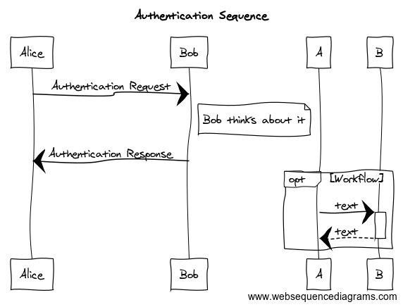
Drawing: WebSequenceDiagrams
title Authentication Sequence
Alice->Bob: Authentication Request
note right of Bob: Bob thinks
Bob->Alice: Authentication Response
opt Workflow
A->+B: text
B-->-A: text
end
Easiest Sequence diagrams ever
Can easily save you work by saving the text
Has different styles for output
Notes:
It only does one thing but it does it really well

Slide 44
Drawing: Plant UML Generation
Major Diagrams
Sequence
Use case
Class
Activity
Component
State
Object
Deployment
Timing
Plus Archimate and others
Text/CLI-based
Can be installed locally
Notes:
If you want UML

Slide 45
Modeling Tools
Tools
Drawing
Modeling
No repository of elements
Each diagram is standalone
Very easy and portable
Think Paper or Whiteboard
Repository of elements
Tied to a framework
Lots of reuse
Maybe too many rules
Diagrams relate
Notes:
There arent that many free modeling tools

Slide 46
Modeling Tools
Beware of the Freemium modeling tools.
You don’t want to pay for an in-app purchase to be able to do something like
“Print”
Notes:
It is my goto .

Slide 47
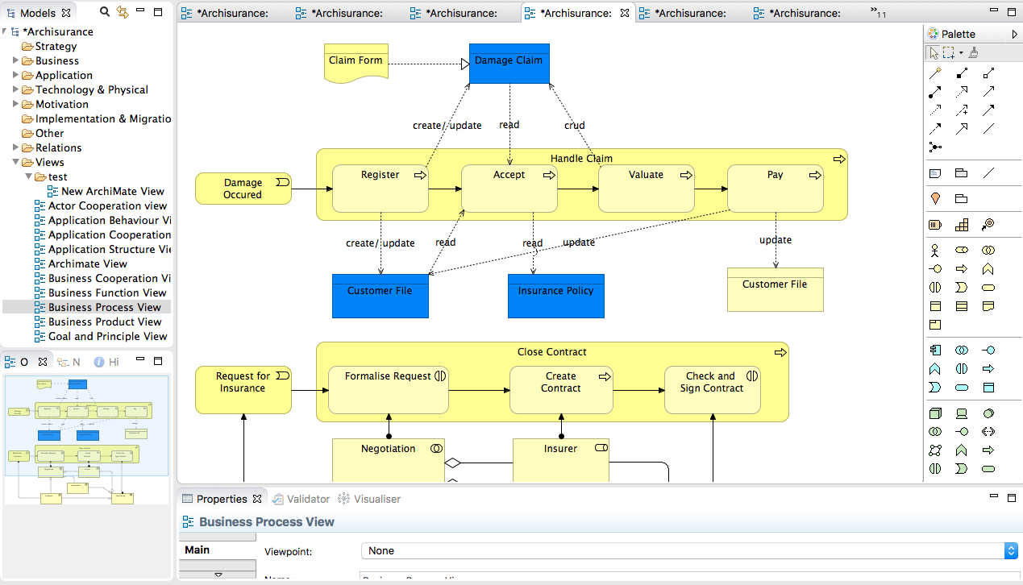
Modeling: Archi
Supports Archimate 3.0
Java-based, cross platform
True element/object modeling, keeps relations and attributes for all
Element reuse
Can create different element collection and views
Not currently multi-user (recognized the issue and developing plugins)
Notes:
Also PowerPoint has some OpenOffice equivalents

Slide 48
Modeling: Eclipse
Unleash the power of Eclipse
Core driver is system and code generation
Complex, terminology, UI, overwhelming feeling of despair
If you are “all in” for Eclipse you need to take a look

Slide 49
Modeling: Essentials
Includes both a framework and a tools
The actual tool, Essential Modeler, is very complex but includes reporting, the Essential Viewer (also complex)
The framework concept is interesting and could be used on its own

Slide 50
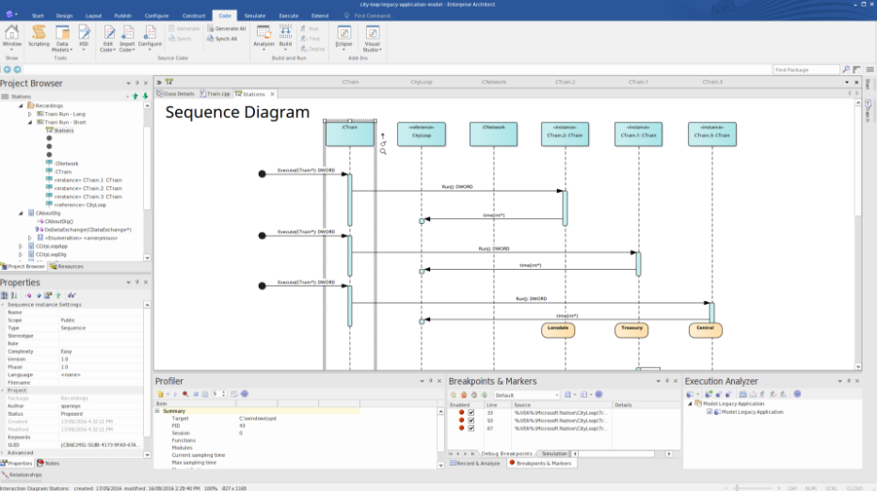
Modeling: Sparx Enterprise Architect (Honorable Mention)
Top of the line drawing app
Low end model is very capable and less than $200
Supports many frameworks including TOGAF, Zachman, Archimate, UML
Best documentation
Notes:
I know I said FREE but this tool is pretty good if you have some money
Watch for Freemium tools or pay to get the real thing offers

Slide 51
REFERENCES
Framework/Languages
Archimate
http://pubs.opengroup.org/architecture/archimate3-doc/
C4
http://www.codingthearchitecture.com/
GML
http://wiki.c2.com/?GalacticModelingLanguage
UML
http://www.uml.org/
Tools
Eclipse
https://eclipse.org/modeling/
Essentials
https://www.enterprise-architecture.org/home.php
Plant UML
http://plantuml.com/
Sparx
http://www.sparxsystems.com/
Visio
https://products.office.com/en-us/visio/flowchart-software?tab=tabs-1

Slide 52

Ready, Set, Architect!
300 seconds to free architecture
Thanks!
Ron Parker
@scmunk
http://www.secretchipmunk.com

